Slide 1
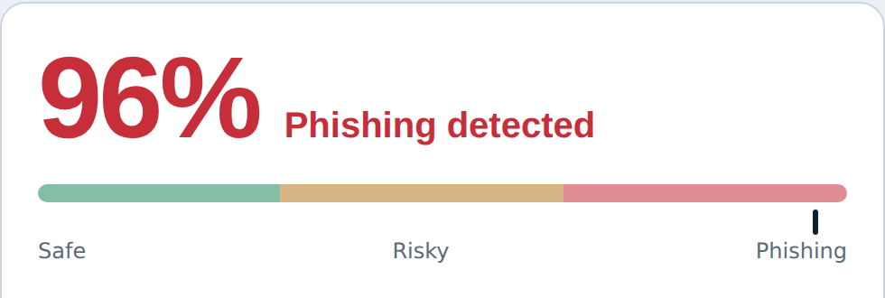
CYBERSHIELD
Suspicious SMS
“Your account will be suspended! Verify immediately…”
AI-Powered Phishing Detection & Risk Analysis
CyberShield reads it
Problem Domain: Cybersecurity
Technology: Machine Learning + NLP
Presented by: Your Name / Team Members
Department | College
Real output from the working prototype
Notes:
Our project is CyberShield, an AI-assisted phishing detection system designed to help users identify suspicious messages and links. (~20 seconds)

Slide 2
Phishing is getting harder to recognize
Phishing is a social-engineering attack: an attacker impersonates a trusted entity to trick a victim into revealing sensitive information or opening a malicious link. Modern attacks rely on impersonation, not obviously fake emails.
₹22,845 cr
Lost to cyber fraud, up 206% from ₹7,465 cr in 2023 (Ministry of Home Affairs, Lok Sabha).
India, 2024
Attackers exploit
$470M
Lost to scams that began as text messages, 5× 2020: fake bank alerts, delivery and toll texts (FTC).
Trust: impersonating banks, companies, government services
Urgency: “Act within 30 minutes”
Fear: “Your account will be blocked”
Rewards: “You've won ₹50,000”
Malicious links: redirecting users to fake websites
US, 2024
$100M+
Paid fake invoices from a spoofed “Quanta Computer”; the fraudster pleaded guilty (US DOJ).
Google & Facebook, 2013–15
Engineering problem: users get convincing messages but have no simple, explainable way to judge a message or URL before interacting. The challenge is not only detecting phishing, but helping users recognize the threat BEFORE they click.
Notes:
Imagine receiving a message saying your bank account will be blocked in 30 minutes. It looks genuine and has a verification link. How does an ordinary user know? Explain phishing, social engineering, urgency, impersonation, then the real incidents: India's ₹22,845 crore cyber-fraud losses in 2024 (MHA), $470M lost to text scams in the US in 2024 (FTC), and the $100M+ fake-invoice phishing of Google and Facebook. Finish: how can we help users assess risk BEFORE they interact? (1–1.5 min)

Slide 3
Our solution: AI-assisted phishing detection
The user pastes a message or URL; CyberShield detects phishing indicators and returns a risk score with an explanation.
Message / URL
Preprocessing
Feature extraction
Classifier
Output
Input
Text + URL
Urgency
Suspicious words
URL patterns
Financial cues
Weighted risk model
Risk score +
classification
Risk Score: 96%
Classification: Phishing
Reasons: urgency detected; suspicious URL; account verification request; financial context
Recommendation: Don't click the link. Verify through the organization's official website or app.
Safe score 0–29%
Risky score 30–64%
Phishing score 65–99%
Why this solution? It combines automated detection with explainability, so non-technical users understand WHY a message is risky.
Notes:
The user provides a message or URL. We preprocess it, extract phishing-related features, pass them to our classifier, and generate a risk score and classification. We also explain the indicators so the user understands the decision. (~1 minute)

Slide 4
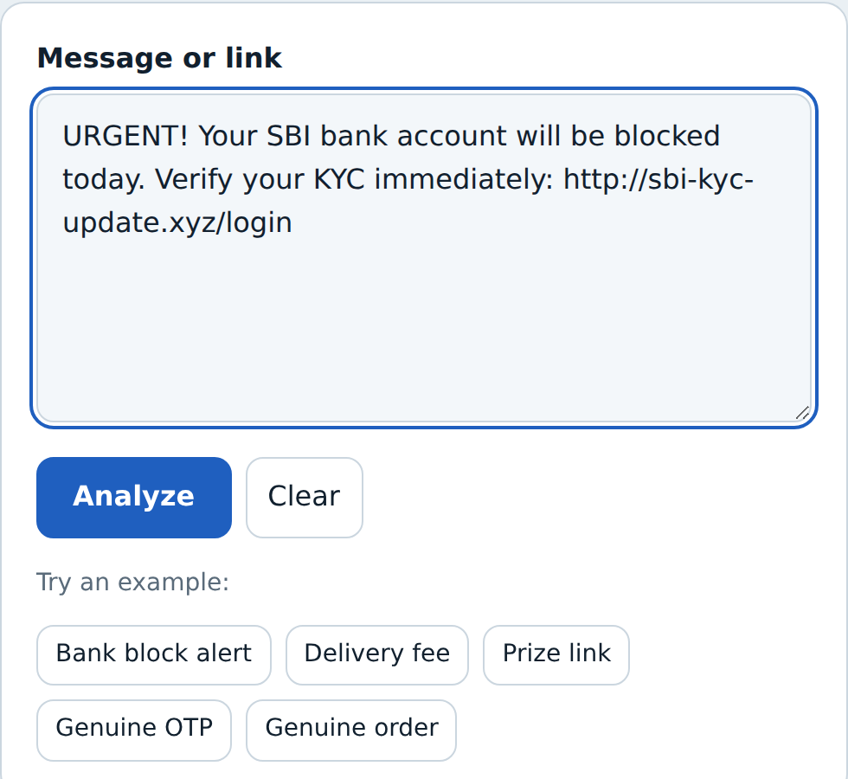
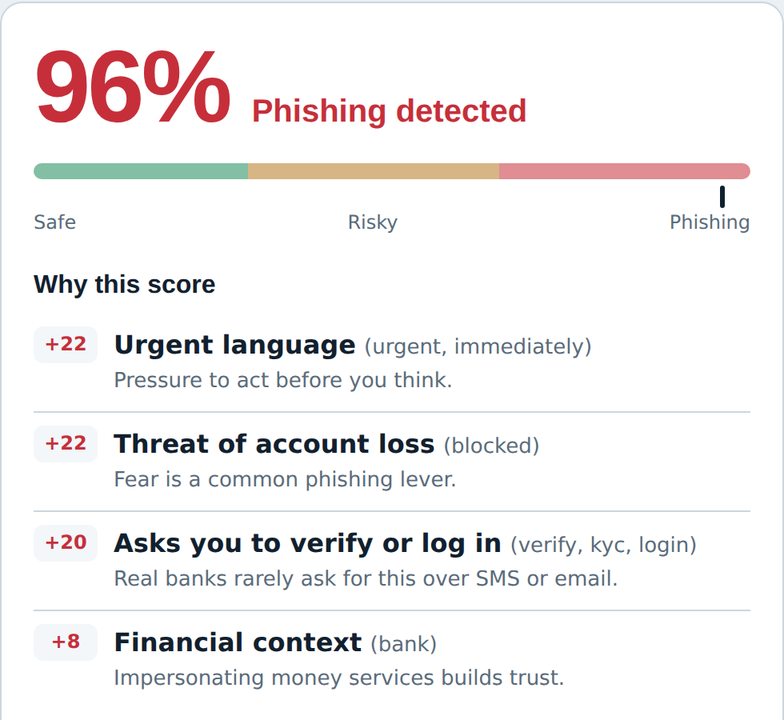
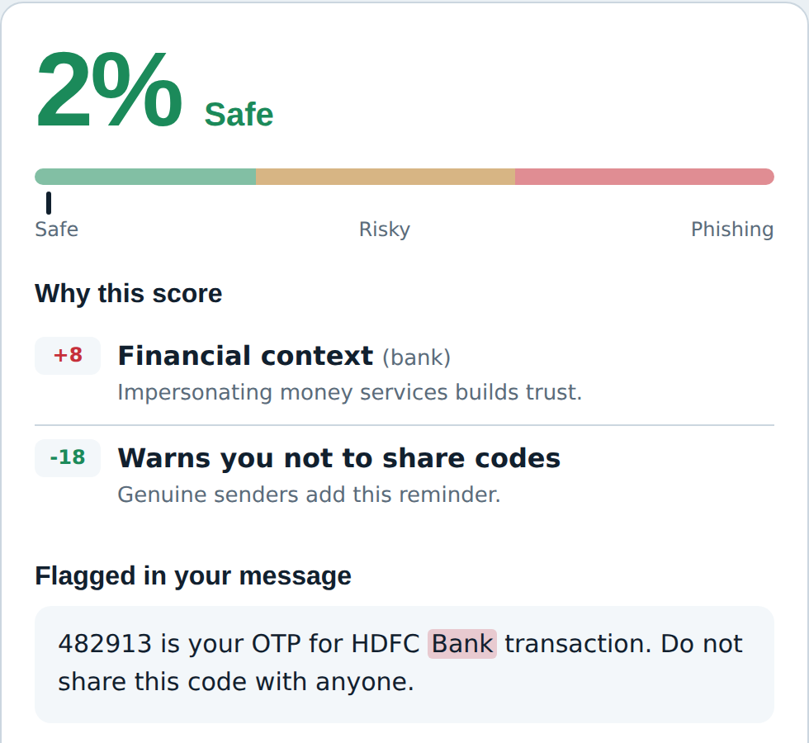
CyberShield working prototype
1. Input
2. Result: phishing, 96%
3. Genuine OTP message: safe, 2%
Paste a suspicious message or URL
Reasons and link check shown
Reassuring cue lowers the score
Input
Analyze
Detect
Explain
Protect
Notes:
Run the live prototype. Paste: URGENT! Your bank account will be blocked. Verify immediately… Click Analyze, show the phishing result, then try a legitimate message and show the safe result. (1–2 minutes)

